Slide 1

Dynamic Pricing for Ride-Sharing
A Reinforcement Learning & Evolutionary Approach
AI-Driven Decision Making
Lecturer : Muhammand Asif Razzaq
Prasanth oddepally , x25205595@ncirl.ie· MSc Artificial Intelligence, NCI
Notes:
Title. One line: 'This project learns a surge-pricing strategy for ride-sharing using reinforcement learning, with a genetic algorithm as a second method.' ~10 seconds.

Slide 2
THE PROBLEM
Surge pricing is powerful — and usually hand-tuned
Set too low
Our approach
1
Revenue is left on the table when demand is high.
Treat pricing as a sequential decision problem
Learn the policy directly from an explicit revenue objective
Balance revenue against customer goodwill
Solve it two independent ways and compare
Set too high
2
Riders churn and long-run demand erodes.
Set by hand
3
Heuristics rarely optimise against a stated objective.
Notes:
The problem. Surge pricing trades revenue against rider retention, but is usually governed by hand-tuned rules. We instead learn the policy against an explicit objective, balancing revenue and goodwill, and we solve it two ways to cross-check. ~35s.

Slide 3
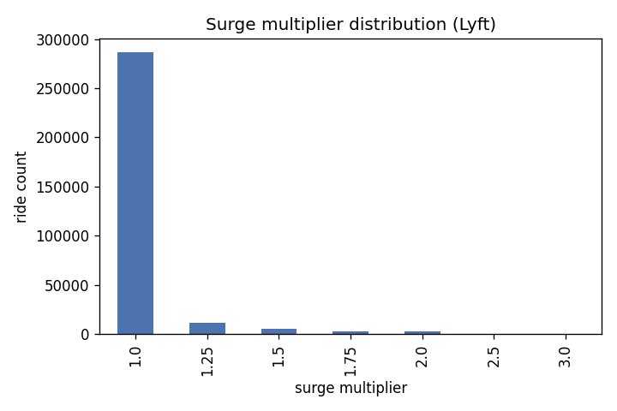
DATA & THE KEY CHALLENGE
The demand curve cannot be read off the data
693k rides, Boston 2018. Only Lyft has varying surge — so we learn on the 307k-ride Lyft subset.
In the data, surge is a RESPONSE to demand, not a cause.
Fitting demand on price would recover the curve backwards — classic endogeneity.
Fix: impose a cited elasticity model; use the data only for baseline demand and fares.
Fig. Surge distribution (Lyft): ~93% of rides sit at 1.0×.
Notes:
Data and the key challenge. Only Lyft carries surge variation, so we use the Lyft subset. Crucially, surge in the data is triggered BY demand, so regressing demand on price gives the curve backwards — endogeneity. We avoid it by imposing a cited demand-elasticity model and using the data only for baseline demand and fares. This is the most important methodological point. ~40s.

Slide 4
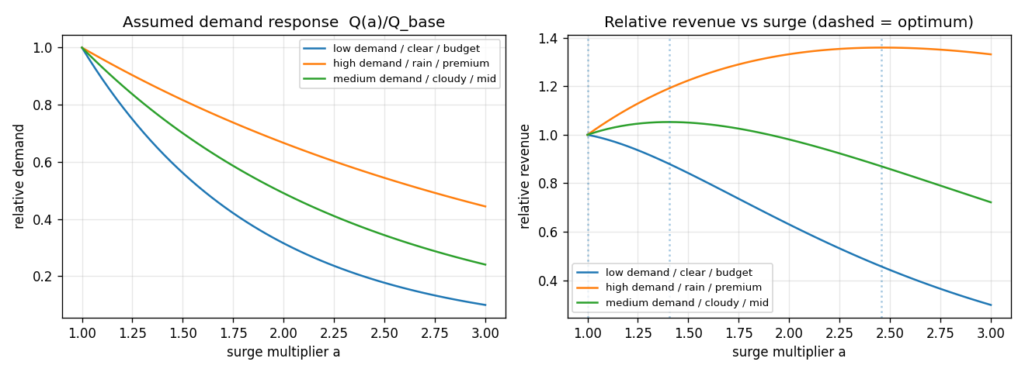
FORMULATION — THE MDP
Pricing as a Markov Decision Process
STATE
ACTION
REWARD
TRANSITION
demand · weather · product · goodwill (270 states)
surge multiplier ∈ {1.0 … 3.0}
revenue − dissatisfaction penalty
goodwill erodes on surge, recovers on rest
Fig. Assumed demand decays with surge; the revenue-optimal surge differs by market regime — the basis for state-dependent pricing.
Notes:
Formulation. An episode is repeated pricing in one market condition over six windows. State is demand, weather, product and a goodwill level; action is the surge multiplier; reward is revenue minus a small dissatisfaction penalty. Demand decays exponentially with surge, and crucially the optimal surge differs by regime — low demand wants ~1.0, high-demand rain wants ~2.5. Goodwill couples the windows, making it a genuine sequential problem. ~45s.

Slide 5
TWO METHODS, ONE OBJECTIVE
A value-based learner vs a black-box optimiser
Q-learning (RL)
Genetic algorithm
value-based · temporal-difference
black-box · population search
Learns Q(s,a) by bootstrapping every step's reward
Exploits the Bellman / MDP structure — sample-efficient
ε-greedy exploration, decaying learning rate
Evolves a full policy; sees only total episode return
No gradient, no Bellman assumption — robust, parallel
Tournament selection · uniform crossover · mutation
Same environment · same fitness · same policy space → differences reflect the search method alone
Notes:
Two methods. The reinforcement learner is tabular Q-learning — it bootstraps off every step and exploits the MDP structure. The genetic algorithm is a black box — it evolves a whole policy and sees only the total return, no Bellman assumption. Both optimise the same fitness over the same policy space, so any difference is down to the search method. ~35s.

Slide 6
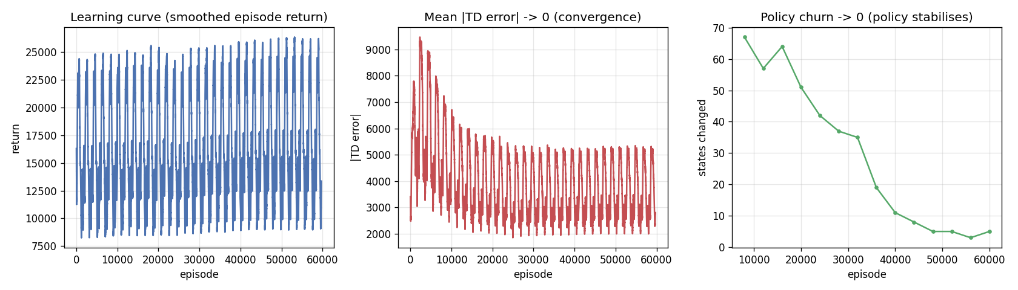
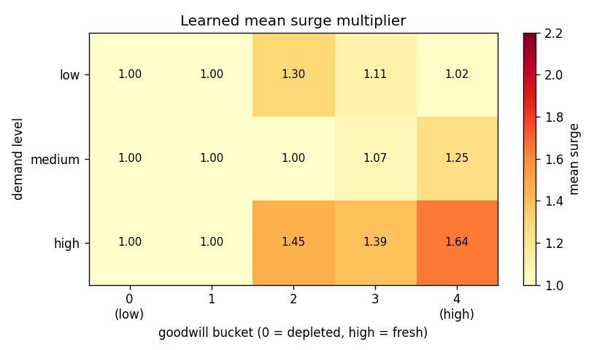
REINFORCEMENT LEARNING — RESULTS
Q-learning converges to a goodwill-aware policy
Fig. Convergence: return rises; TD error and policy churn fall to zero.
The agent learned to pulse — surge while goodwill is fresh, then rest to let it recover. No rule was hand-coded; it emerged from reward alone.
Fig. Learned policy: surge rises with demand, eases as goodwill depletes.
Notes:
RL results. Three convergence signals — return rising, TD error and policy churn falling to zero. The heatmap shows what it learned: surge increases with demand and eases off as goodwill depletes. It discovered a pulsing strategy — surge while goodwill is fresh, rest to recover — entirely from reward. ~35s.

Slide 7
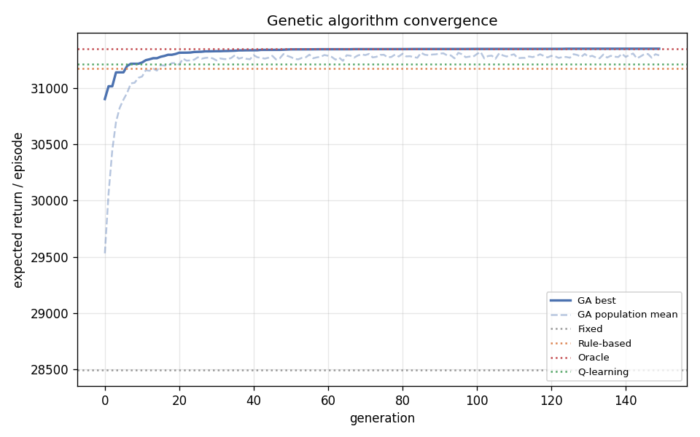
GENETIC ALGORITHM — RESULTS
Evolution reaches the same optimum, independently
99%
of final fitness by generation 27
Converges to the oracle ceiling
Independently finds the same pulsing structure as RL
Two paradigms agreeing = strong validation
Fig. Best & mean fitness per generation, vs baselines and the oracle.
Notes:
GA results. The genetic algorithm reaches 99% of its final fitness within about 27 generations and converges to the oracle ceiling. It independently discovers the same pulsing structure as Q-learning — two very different methods agreeing is strong evidence the structure is real, not an artefact. ~30s.

Slide 8
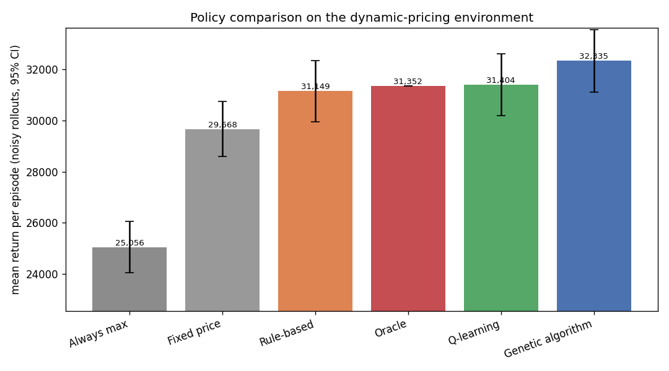
BASELINE COMPARISON
Both learners beat every simple baseline
+9.6%
Q-learning vs fixed pricing
+10.0%
Genetic algorithm — matches oracle
p < 0.01
paired test: +1,108 / +1,191 per episode
Ranking: GA ≥ Q-learning > rule-based > fixed > always-max
Fig. Mean return per episode, noisy rollouts with 95% CIs.
Notes:
Comparison. Both learners beat all three simple baselines — fixed, always-max, and a rule-based heuristic. Q-learning lifts revenue 9.6% over flat pricing; the GA reaches 10%, matching the oracle ceiling. A paired test confirms the gains are statistically significant. ~30s.

Slide 9
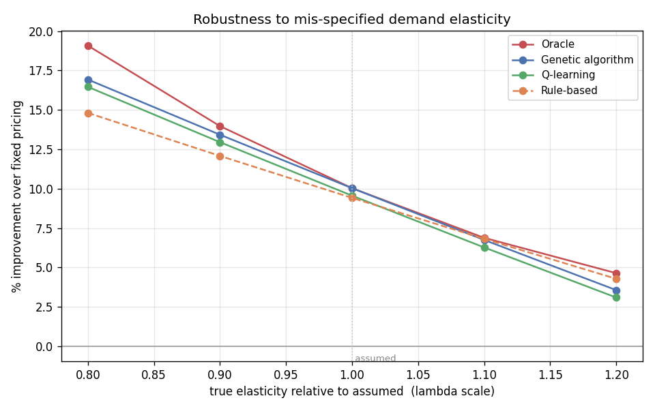
ROBUSTNESS
The result survives the assumption being wrong
Elasticity is imposed, so we test mis-specification:
Both learners beat fixed pricing across the whole ±20% band and track the oracle.
Held-out test: +10.1% train → +10.0% on unseen markets (0.1-pt gap — not overfit).
The conclusion does not hinge on the exact elasticity value.
Fig. Gain over fixed pricing as the true elasticity is scaled ±20%.
Notes:
Robustness. Because elasticity is an assumption, we scale the true value by plus or minus 20%. Both learned policies still beat fixed pricing across the whole range and track the oracle. A held-out test shows near-identical performance on unseen markets — a 0.1-point gap — so it isn't overfit. The conclusion doesn't depend on getting the elasticity exactly right. ~35s.

Slide 10
Conclusion
Endogeneity handled by design
A cited elasticity model turns static data into a valid pricing MDP.
Two methods, one policy
Q-learning and a genetic algorithm both learn a goodwill-aware pulsing strategy.
+9.6% / +10.0% over fixed pricing
Statistically significant, matching a goodwill-aware oracle.
Robust & general
Holds under ±20% elasticity error and on unseen markets.
Thank you
Notes:
Conclusion. We formulated surge pricing as an MDP, carefully avoiding the endogeneity trap, and solved it two independent ways. Both learn a goodwill-aware pulsing policy that raises revenue about 10% over flat pricing, is statistically significant, matches the oracle, and stays robust under mis-specified elasticity and on unseen markets. Thank you. ~30s.

